Slide 1
Autonomous underwater vehicles (auvs) control systems
Control Theory (ct) seminar
sumit arjune (64)
Vaishnavi Deshmukh (66)
Gaurav Thamke (77)
Darshan Rajput(74)

Slide 2
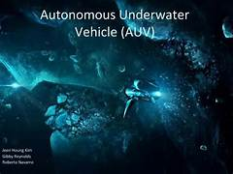
content
What is Autonomous underwater vehicles (auvs) control systems?
MAYA - India’s first Indigenously developed AUV
Applications of AUVs
Research study outcomes on AUVs
Role of AI in AUV Control Systems
Future Scope in AUVs
Conclusion

Slide 3
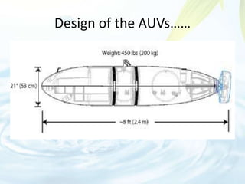
What is Autonomous underwater vehicles (auvs) control systems?
Autonomous Underwater Vehicles (AUVs) are self-propelled, unmanned vehicles designed to operate underwater without direct human intervention.
Control systems in AUVs manage navigation, stability, and performance of the vehicle. These systems are crucial for the successful operation of AUVs in various underwater missions.

Slide 4
What is an auv?
AUVs are designed to perform tasks underwater autonomously. They can navigate, collect data, and execute pre-programmed missions without real-time control from operators.
Key Components of AUVs:
Navigation Systems: GPS (for surface navigation), Inertial Navigation Systems (INS),
Sensors: Sonar, cameras, magnetometers, chemical sensors.
Communication Systems: Acoustic modems, satellite links for surface communication.

Slide 5
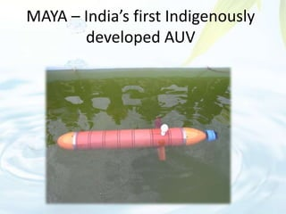
MAYa - india’s first indigenously developed auv

Slide 6
MAYa - india’s first indigenously developed auv
Maya AUV is an autonomous underwater vehicle (AUV), developed by the Marine Instrumentation Division at the National Institute of Oceanography (NIO), India.
MAYA - Automated Underwater Vehicle developed by NIO 2019-07-08 16:33:23 National Institute of Oceanography (N.I.O), Goa, has developed a small autonomous underwater vehicle (AUV) ‘Maya’ as a tool for scientific and commercial applications.
The development of Maya was jointly funded by NIO and the Department of Electronics and Information Technology, New Delhi, India (known as the Department of Information Technology before 2012).

Slide 7
applications of auvs
Search and Rescue Operations: Locating sunken vessels, rescuing trapped divers.
Seafloor Mapping and Surveying: High-resolution mapping for geological studies.
Pipeline and Cable Inspection: Routine checks and maintenance of underwater infrastructure.
Marine Habitat Monitoring: Assessing health of marine ecosystems, studying fish populations.
Water Quality Assessment: Measuring parameters like temperature, salinity, and pollution levels.

Slide 8
Research study outcomes on auvs
Improved Navigation and Localization: Advanced algorithms for precise underwater positioning.
Enhanced Sensor Technology: Development of better imaging systems, chemical and biological sensors.
Development of Adaptive Control Systems: Systems that can adjust to changing underwater environments.

Slide 9
Role of ai in auv control systems
AI Algorithms for Navigation and Obstacle Avoidance: Machine learning models to enhance real-time navigation and obstacle detection.
Machine Learning for Adaptive Mission Planning: AI to adjust mission parameters based on real-time data.
Data Analysis and Decision-Making: AI processing sensory data to make informed decisions during missions.
Real-Time Processing of Sensory Data: AI enabling quick response to environmental changes and potential hazards.

Slide 10
Future scope in auvs
Advancements in Autonomy and AI: Enhancing decision-making capabilities, enabling complex missions without human input.
Integration with Other Autonomous Systems: Collaboration with aerial drones and surface vehicles for comprehensive monitoring.
Expansion in Commercial Applications: Increased use in aquaculture, underwater construction, and tourism.
Enhancements in Battery Life and Energy Efficiency: Development of new power sources, longer mission durations.
Development of Swarming Capabilities: Multiple AUVs working together to cover larger areas and perform complex tasks.

Slide 11
conclusion
By leveraging advanced control systems and AI, AUVs will continue to push the boundaries of what is possible in underwater technology, leading to new discoveries and improved management of underwater resources.

Slide 12
references
https://www.sciencedirect.com/science/article/pii/S0025322714000747
https://ieeexplore.ieee.org/document/10085754
https://www.mdpi.com/2076-3417/13/13/7732
https://www.sciencedirect.com/science/article/abs/pii/S0029801819301623
https://www.sciencedirect.com/science/article/abs/pii/S0029801823002457

